Slide 1
Keeping up with the Commodore
1980s performance optimization lessons still applicable today
Dennis Dietrich Manager Software Development ICS, Phoenix Contact
Rev. 1 (2025-??-??), https://github.com/dennisdietrich/KeepingUp/

Slide 2


**** COMMODORE 64 BASIC V2 ****
64K RAM SYSTEM 38911 BASIC BYTES FREE
READY.
Keeping up with the Commodore
1980s performance optimization
lessons still applicable today
Dennis Dietrich
Manager Software Development ICS
Phoenix Contact

Slide 3

Lessons of Hanoi

Slide 4
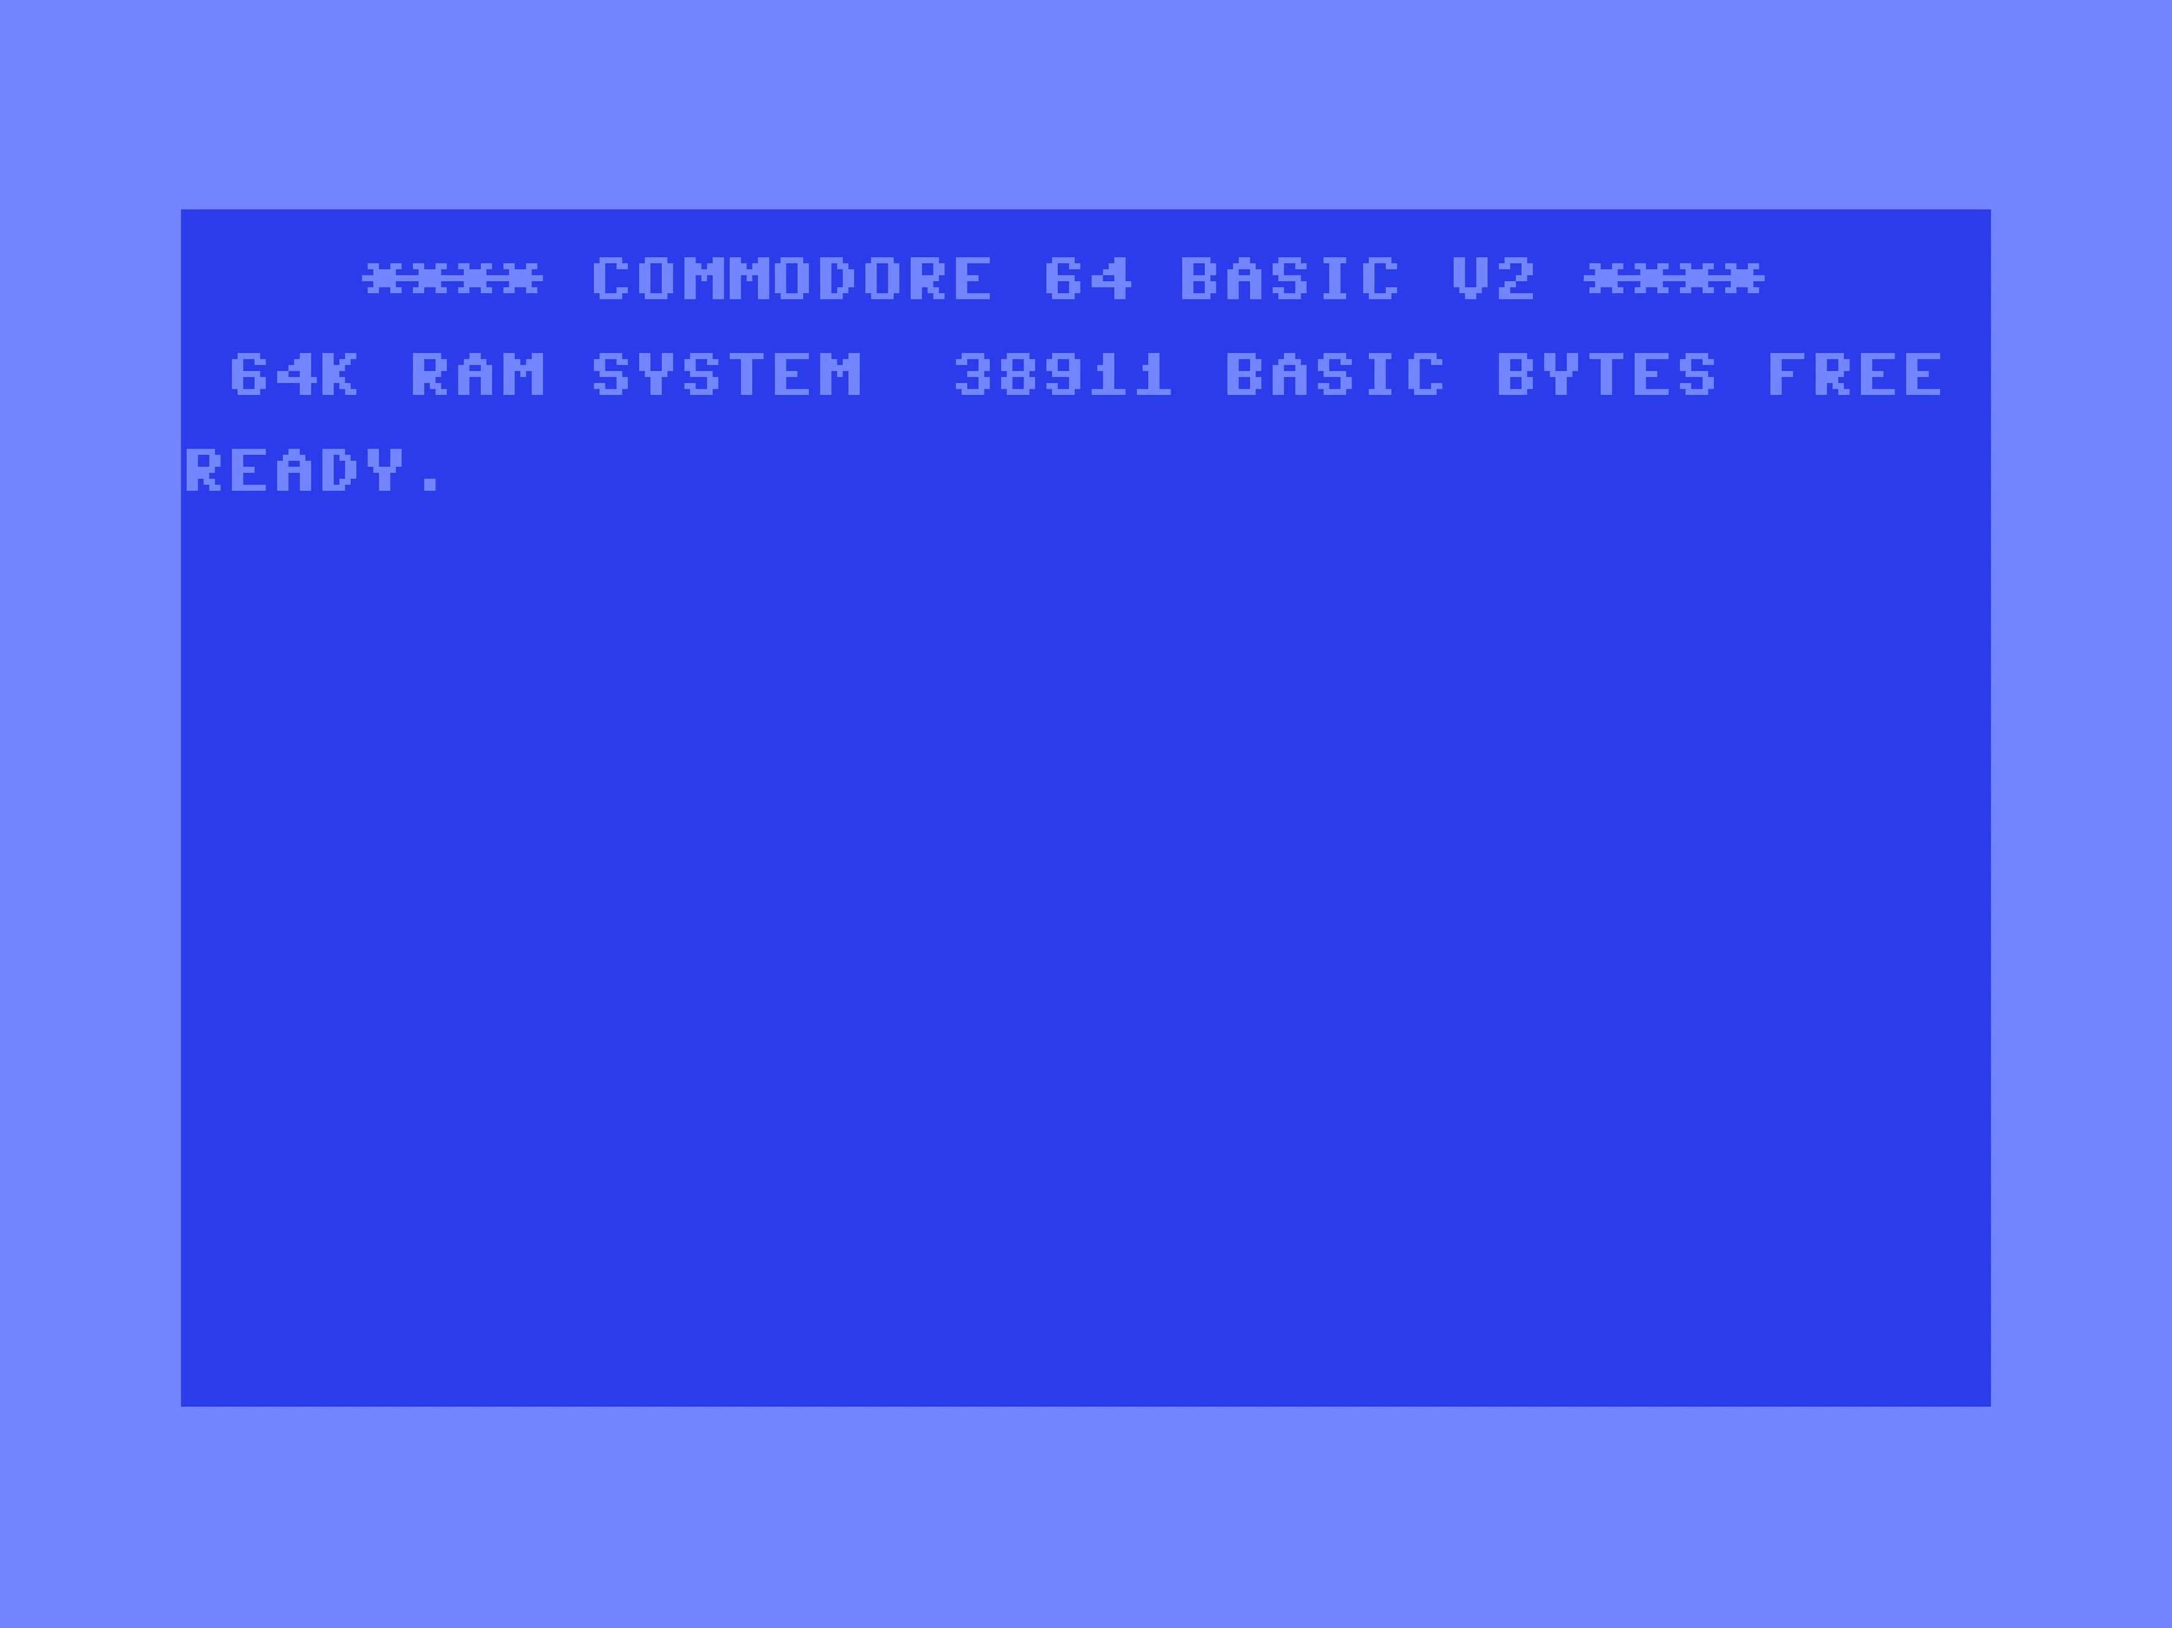

Slide 5
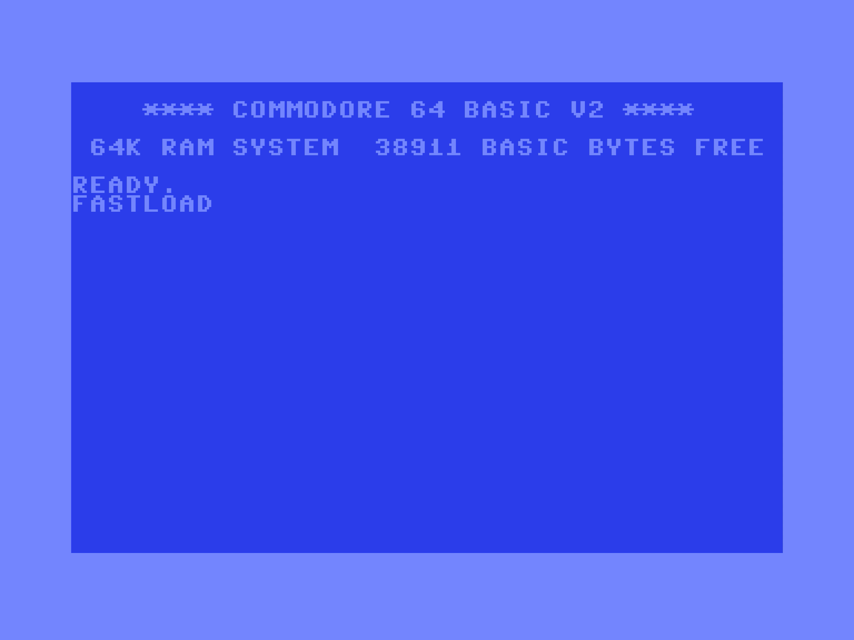
700 REM *** DISPLAY DISK MOTION ***
710 FOR Y = 200 TO 100 STEP - 1 : POKE V - 1 + 2 * S, Y : NEXT Y
720 FOR X = (TF - 1) * 96 + 52 TO (TT - 1) * 96 + 52 STEP SGN(TT - TF)
730 POKE V - 2 + 2 * S, X : NEXT X
740 FOR Y = 100 TO 200 : POKE V - 1 + 2 * S, Y : NEXT Y
750 RETURN

Slide 6
700 REM *** DISPLAY DISK MOTION ***
710 FOR Y = 200 TO 140 STEP - 2 : POKE V - 1 + 2 * S, Y : NEXT Y
720 FOR X = (TF - 1) * 96 + 52 TO (TT - 1) * 96 + 52 STEP SGN(TT - TF) * 2
730 POKE V - 2 + 2 * S, X : NEXT X
740 FOR Y = 140 TO 200 STEP 2 : POKE V - 1 + 2 * S, Y : NEXT Y
750 RETURN

Slide 7
Lessons of Hanoi
Notes:
Disney+ iOS app staring animation as a modern example of the first point?
Mention power consumption as a (modern) caveat of the third point

Slide 8
Lessons of Hanoi
* User interface performance is
subjective
Notes:
Disney+ iOS app staring animation as a modern example of the first point?
Mention power consumption as a (modern) caveat of the third point

Slide 9
Lessons of Hanoi
* User interface performance is
subjective
* Bad performance can be a
specification defect
Notes:
Disney+ iOS app staring animation as a modern example of the first point?
Mention power consumption as a (modern) caveat of the third point

Slide 10
Lessons of Hanoi
* User interface performance is
subjective
* Bad performance can be a
specification defect
* Maximum performance may be
irrelevant for user experience
Notes:
Disney+ iOS app staring animation as a modern example of the first point?
Mention power consumption as a (modern) caveat of the third point

Slide 11
ELIZA's Lessons

Slide 12


Falken's Lessons

Slide 13
The Final Lesson

Slide 14


Slide 15


Slide 16



Questions?
dennisdietrich
dcdietrich
@dc@social.advancedsoftware.engineering

Slide 17

Thanks for listening!
dennisdietrich
dcdietrich
@dc@social.advancedsoftware.engineering

